Slide 1
Optimizando aplicaciones en la nube de Azure
Luis Ruvalcaba Sánchez
Cloud Solution Architect
Microsoft LATAM
linkedin.com/in/luisruvalcaba
@luisruvals

Slide 2
Agenda
The Azure Well-Architected Framework
Demo: Azure Well-Architected Review
Monitoring your application
Q&A

Slide 3






Azure Well-Architected Framework
The Microsoft Azure Well-Architected Framework provides guidance and architectural best practices developed for architects and solution owners to improve the quality of their workloads based on five pillars:
Cost
Optimization
Operational Excellence
Performance efficiency
Security
Reliability

Slide 4
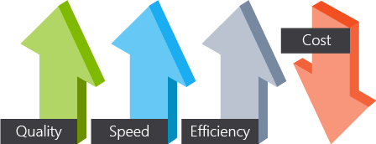
Cost optimization
You'll want to design your cloud environment so that it's cost-effective for operations and development. Identify inefficiency and waste in cloud spending to ensure you're spending money where you can make the greatest use of it.

Slide 5
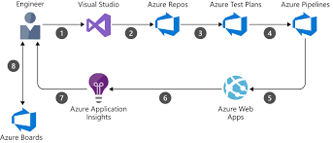

Operational excellence
By taking advantage of modern development practices, such as DevOps, you can enable faster development and deployment cycles. You need to have a good monitoring architecture in place so that you can detect failures and problems before they happen or, at a minimum, before your customers notice. Automation is a key aspect of this pillar to remove variance and error while increasing operational agility.

Slide 6
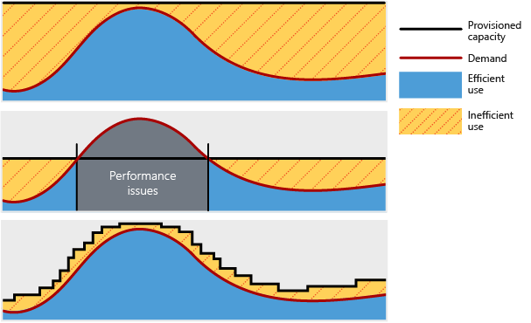
Performance efficiency
For an architecture to perform well and be scalable, it should properly match resource capacity to demand. Traditionally, cloud architectures accomplish this balance by scaling applications dynamically based on activity in the application. Demand for services changes, so it's important for your architecture to be able to adjust to demand. By designing your architecture with performance and scalability in mind, you'll provide a great experience for your customers while being cost-effective.

Slide 7
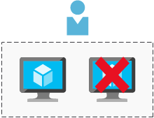
Reliability
Every architect's worst fear is having an architecture fail with no way to recover it. A successful cloud environment is designed in a way that anticipates failure at all levels. Part of anticipating failures is designing a system that can recover from a failure within the time that your stakeholders and customers require.

Slide 8
Sample reference architecture

Slide 9
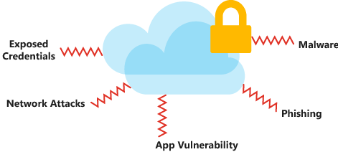
Security
Data is the most valuable piece of your organization's technical footprint. In this pillar, you'll focus on securing access to your architecture through authentication and protecting your application and data from network vulnerabilities. The integrity of your data should be protected too, through tools like encryption.
You must think about security throughout for the entire lifecycle of your application, from design and implementation to deployment and operations. The cloud provides protections against a variety of threats, such as network intrusion and DDoS attacks.

Slide 10
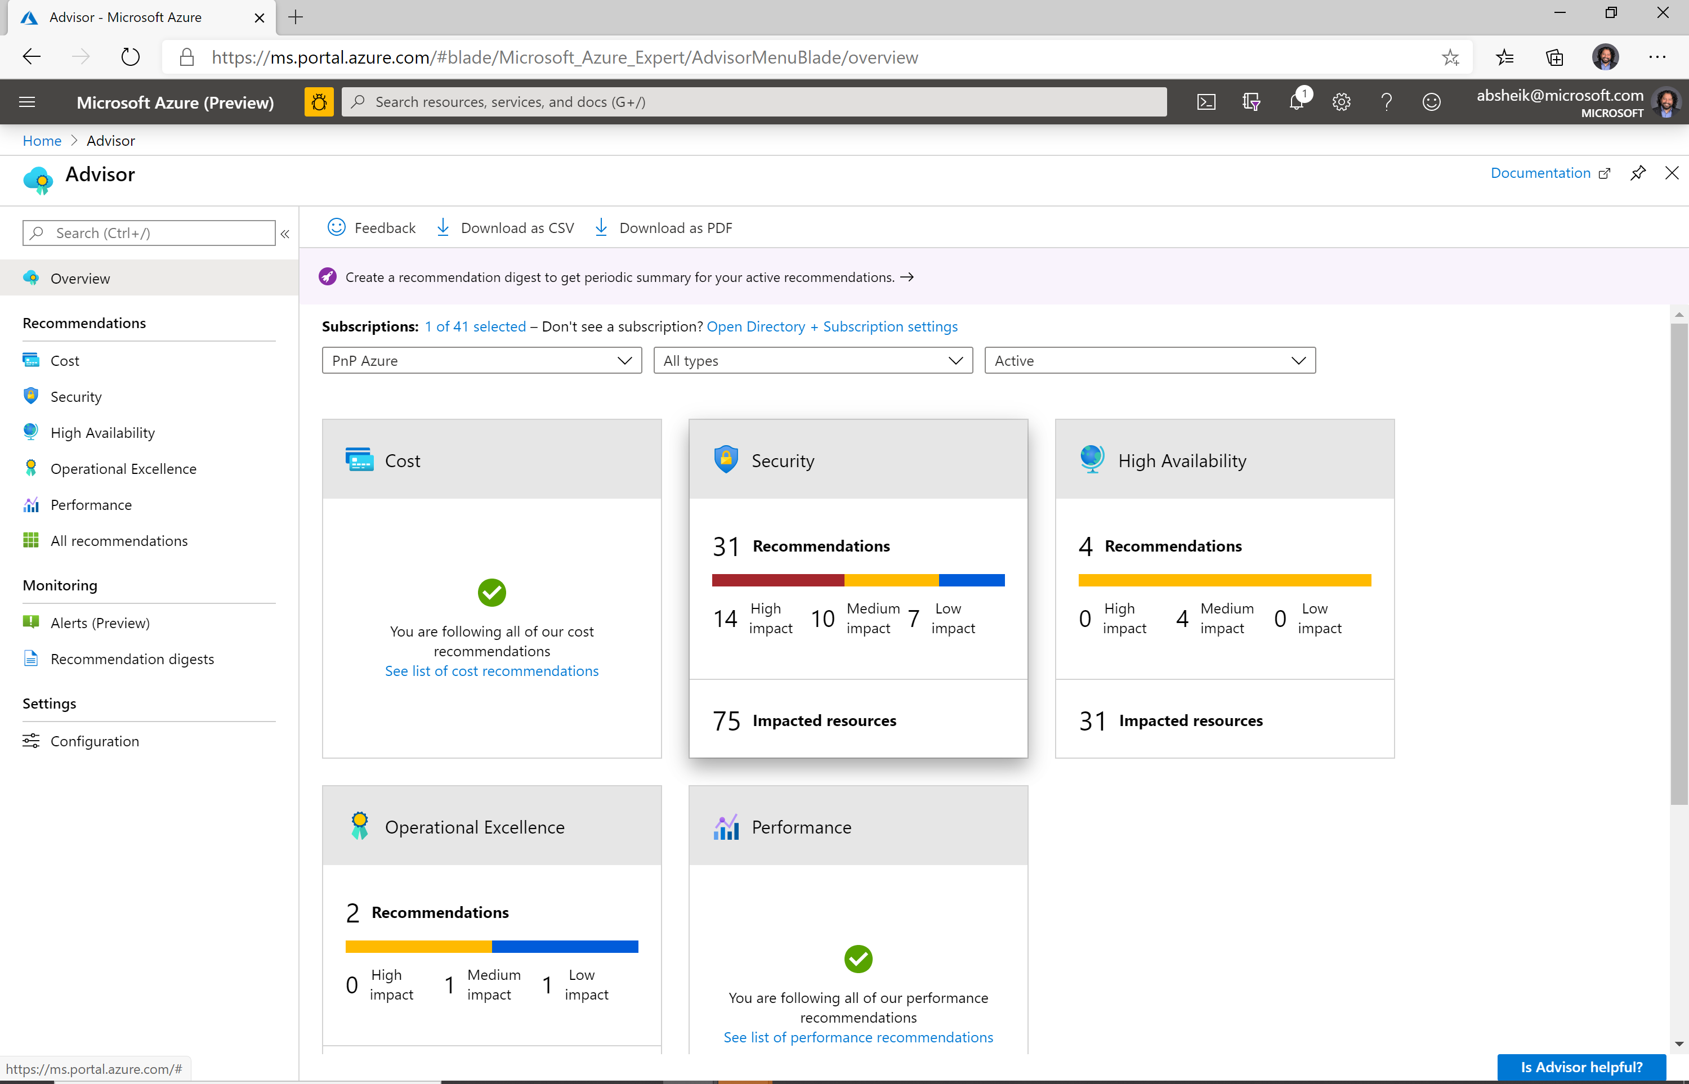
Azure Advisor
Resources already deployed
Advisor recommends improvement actions
Workload you are envisioning
Align to your organization Advisor recommendations for common environment like a landing zone with Application monitoring infrastructure, Identity, and Security posture that the enterprise has laid out.
https://aka.ms/azureadvisordocs

Slide 11
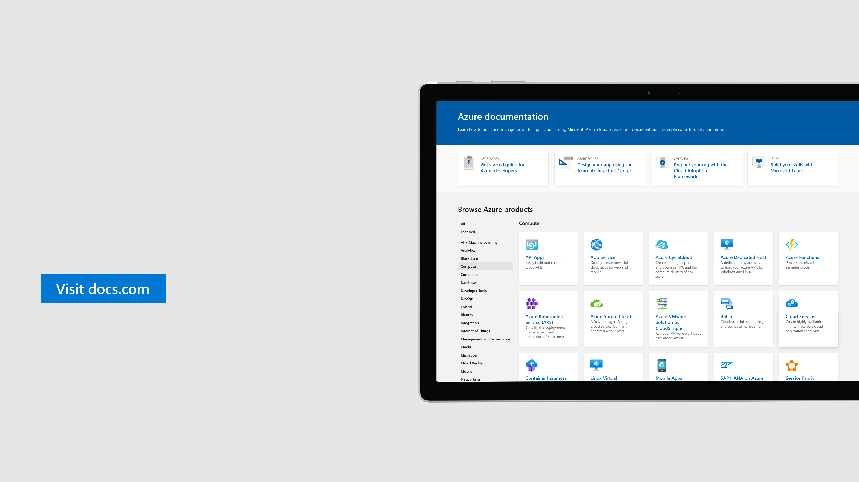
Microsoft Docs
Guidance from experts
Explore overviews, tutorials, code samples, and more.
Azure well-architected framework
Notes:
The Azure Well-Architected Framework lives on Docs, and you can see it today by visiting https://aka.ms/theframework

Slide 12
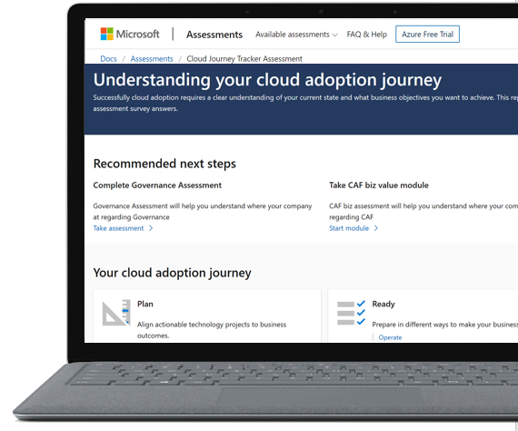
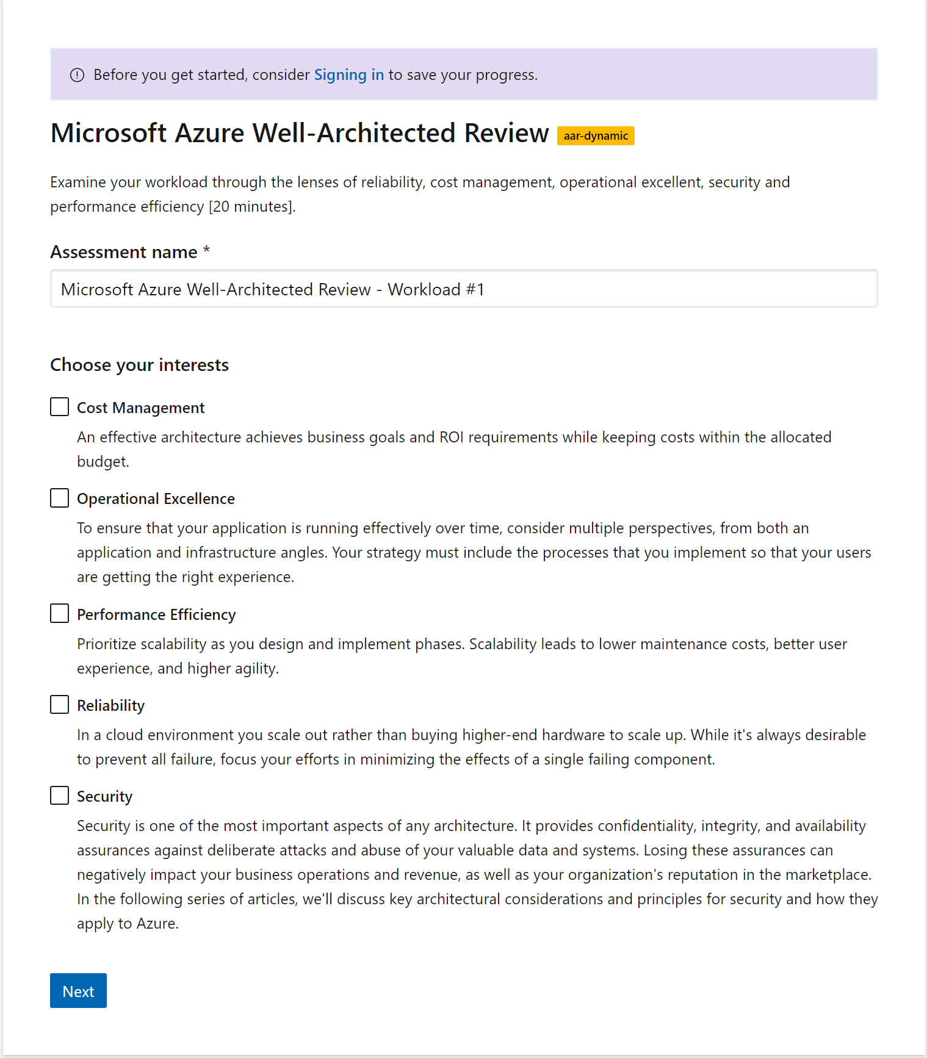
Resources
Microsoft Azure Well-Architected Review
https://aka.ms/architecture/review

Slide 13
Demo: Azure Well-Architected Review
https://docs.microsoft.com/en-us/assessments/
Notes:
Now that we know a little more about the Azure Well-Architected Framework, we want to transition into the Azure Well-Architected Review. The purpose of the review is to help workload owners identify opportunities to optimize based on the five pillars we discussed previously. For this scenario, and for the sake of time, we’re going to evaluate a basic workload with cost optimization in mind. Upon completion of this assessment, we will receive targeted recommendations that will help us evaluate and prioritize these opportunities.
Sample: https://docs.microsoft.com/en-us/azure/architecture/reference-architectures/containers/aks-microservices/aks-microservices
Tool: https://docs.microsoft.com/en-us/azure/architecture/framework/
Assesments: https://docs.microsoft.com/en-us/assessments/

Slide 14
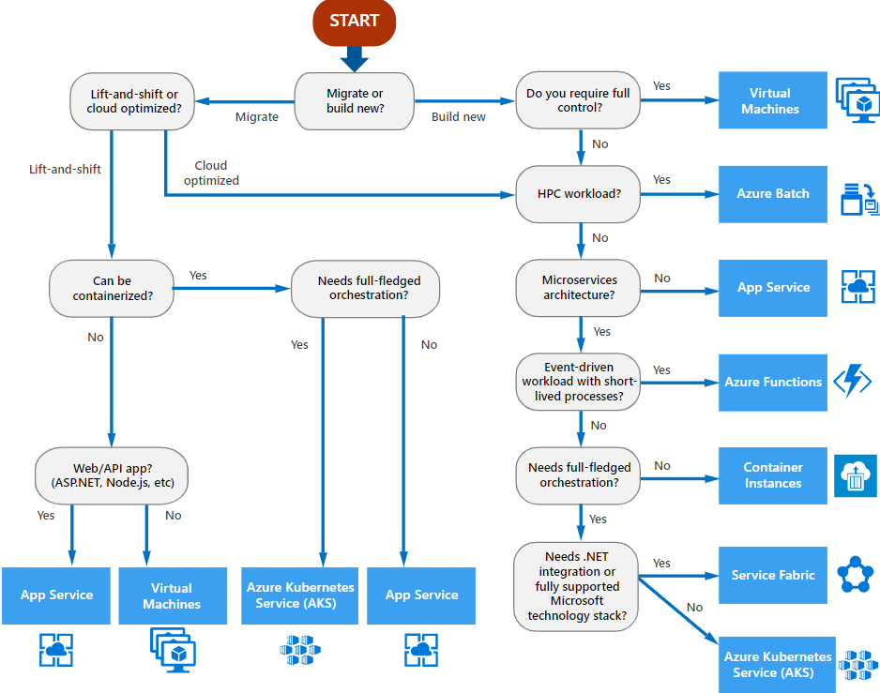
Choosing right
Cloud Optimized is a strategy for migrating to the cloud by refactoring an application to take advantage of cloud-native features and capabilities
The output from this flowchart is a starting point for consideration. Next, perform a more detailed evaluation of the service to see if it meets the needs of your business.

Slide 15















Azure Monitor
Insights
Application
Container
VM
Monitoring Solutions
Application
Operating System
Visualize
Metrics
Dashboards
Views
Power BI
Workbooks
Azure Resources
Azure Subscription
Analyze
Logs
Metrics Explorer
Log Analytics
Azure Tenant
Respond
Custom Sources
Alerts
Autoscale
Integrate
Event Hubs
Logic Apps
Ingest & Export APIs

Slide 16

Application Insights

Slide 17
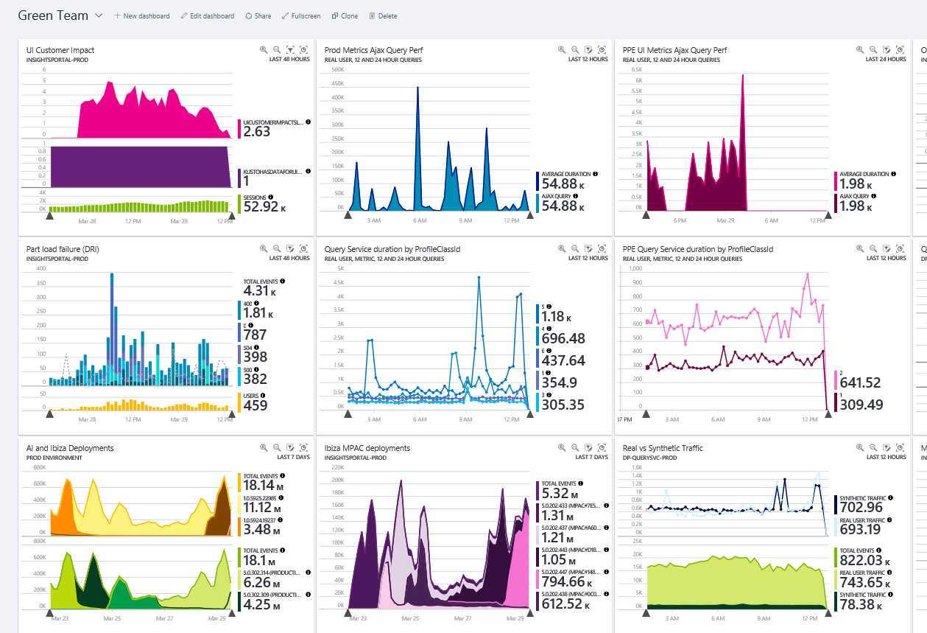
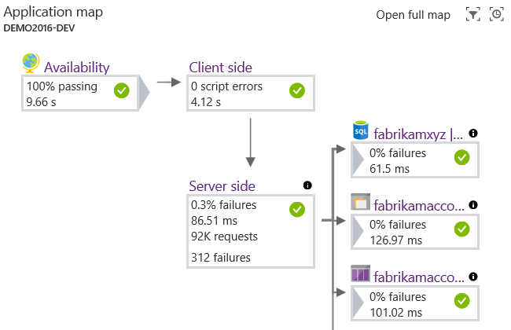

Slide 18
Demo
Application Insights
Notes:
Now that we know a little more about the Azure Well-Architected Framework, we want to transition into the Azure Well-Architected Review. The purpose of the review is to help workload owners identify opportunities to optimize based on the five pillars we discussed previously. For this scenario, and for the sake of time, we’re going to evaluate a basic workload with cost optimization in mind. Upon completion of this assessment, we will receive targeted recommendations that will help us evaluate and prioritize these opportunities.
Sample: https://docs.microsoft.com/en-us/azure/architecture/reference-architectures/containers/aks-microservices/aks-microservices
Tool: https://docs.microsoft.com/en-us/azure/architecture/framework/
Assesments: https://docs.microsoft.com/en-us/assessments/

Slide 19
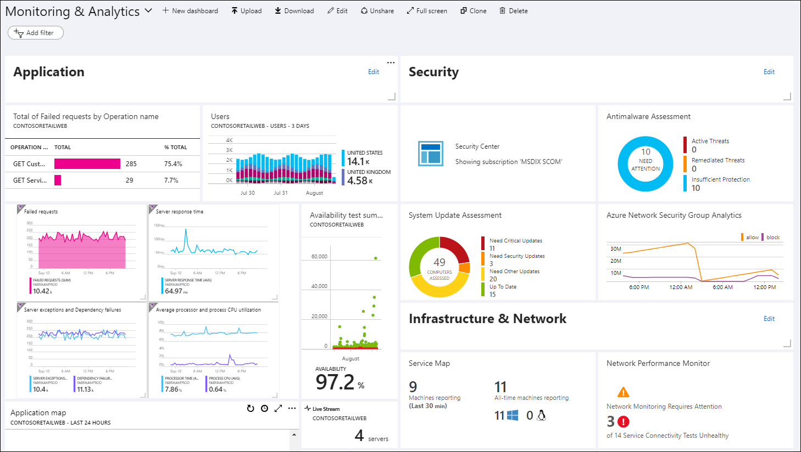
Documentation
Azure Monitor
https://aka.ms/appinsights

Slide 20
Thank you
Luis Ruvalcaba
Cloud Solution Architect
Microsoft LATAM
linkedin.com/in/luisruvalcaba

